Slide 1

Classify space rocks by using Python and artificial intelligence
Abhigya Verma Microsoft Learn Student Ambassador Alpha

Slide 2
Module 2: Prepare to research space rocks by using artificial intelligence Learn about the scientific research of space rocks and how artificial intelligence can enhance this study.
Abhigya Verma Microsoft Learn Student Ambassador Alpha
Notes:
You're a geologist working for NASA. Your job is to let the astronauts know which rocks to pick up on their trip to the Moon. (You would go to the Moon to pick them out yourself, but you have a fear of heights). Because astronauts have many other things to learn, teaching them about different space rocks isn't practical. Instead, you decide to create an artificial intelligence (AI) program that the astronauts can use to take a photo of a rock and find out what type of rock it is. Providing an AI program for astronauts helps ensure that you get enough samples of every type of rock you need.
In this Microsoft Learn module, you'll learn what AI is, and you'll use some libraries that will help you create a program that classifies rocks. The final project uses Visual Studio Code, Python, and Jupyter Notebook to create an AI model that can identify the type of a rock in an image.
The data is provided by NASA. Explore more interesting photos in NASA's sample collection.

Slide 3
Learning objectives
In this module, you'll learn:
Get an introduction to artificial intelligence
Discover how humans classify objects
Discover how machines classify objects
Learn about artificial intelligence libraries
Install artificial intelligence libraries

Slide 4
Prerequisites
Ability to write and run basic Python programs
Visual Studio Code, with the Python extension installed

Slide 5
Artificial intelligence and space rock research
Notes:
AI is a fairly new but prominent concentration in the field of computer science, and more specifically, data science. The main concept of AI is teaching a computer how to learn things. The computer then makes decisions based on what it has learned.
You might think teaching computers how to "think" on their own could lead to extinction of the human race. But we don't need to worry about computers taking over the world. Computers need humans to do the programming. We benefit from programming computers with AI. Here are a few examples of how AI works to improve our lives:
Netflix uses AI algorithms to recommend what we might like to watch next.
Siri runs AI on our phone data to detect patterns and help us do common tasks more easily.
Tesla implements AI to make driverless cars, so everyone can sit back and enjoy the view.
AI works by giving many different pieces of data to a computer, and telling it what the data means. For our exercise, we'll give the computer many images of different types of space rock and teach it about the types of rock. We'll upload a photo of basalt rock and tell the computer: This photo shows basalt rock.
This process is the first step of building an AI model. We use AI models to make predictions. After we show the computer a large number of images, we create a model from the data. Then we can give the computer a new photo and the computer uses the model data to predict the type of rock in the image.
When you use AI, you'll see the terms machine learning and artificial intelligence used almost interchangeably. The main difference between the terms is that machine learning is a type of AI. The concepts are similar, but in this lesson, we focus on AI.

Slide 6
Space rock types and features
Notes:
Let's start by learning about the different types of space rocks that we'll be studying. You'll get a chance to see how well you do at classifying Moon rocks.

Slide 7
Moon rocks: Dissect the Moon
Notes:
In this lesson, we'll use two types to classify rocks: basalt and highland (also known as crustal). Both of these rock types are found on the Earth. But for our study, we'll look only at the lunar variants; that is, rocks from the Moon.

Slide 8
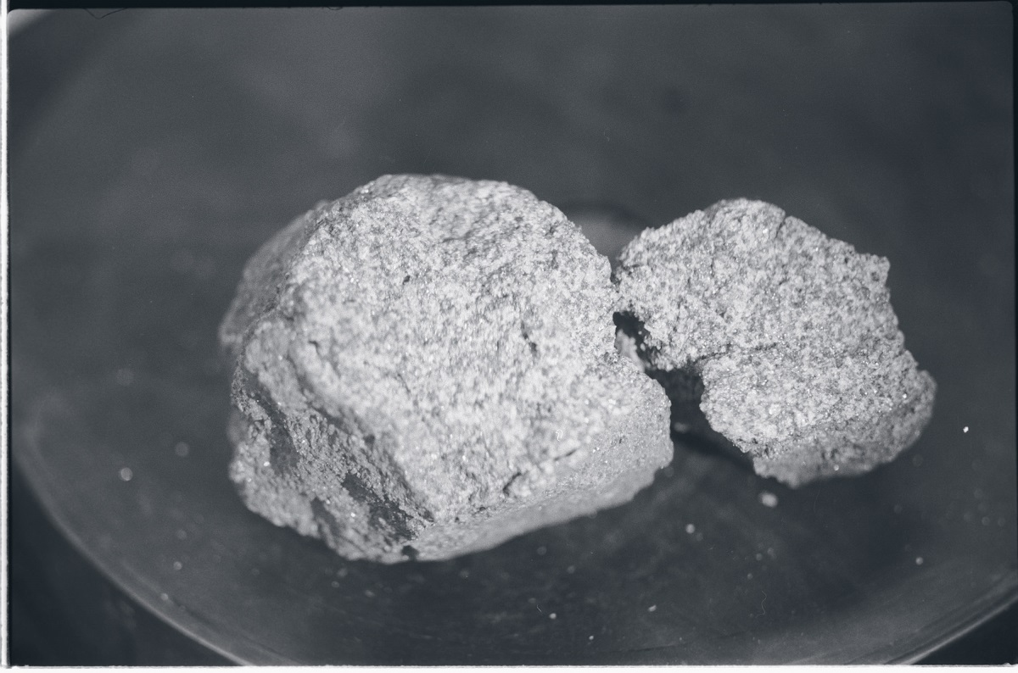
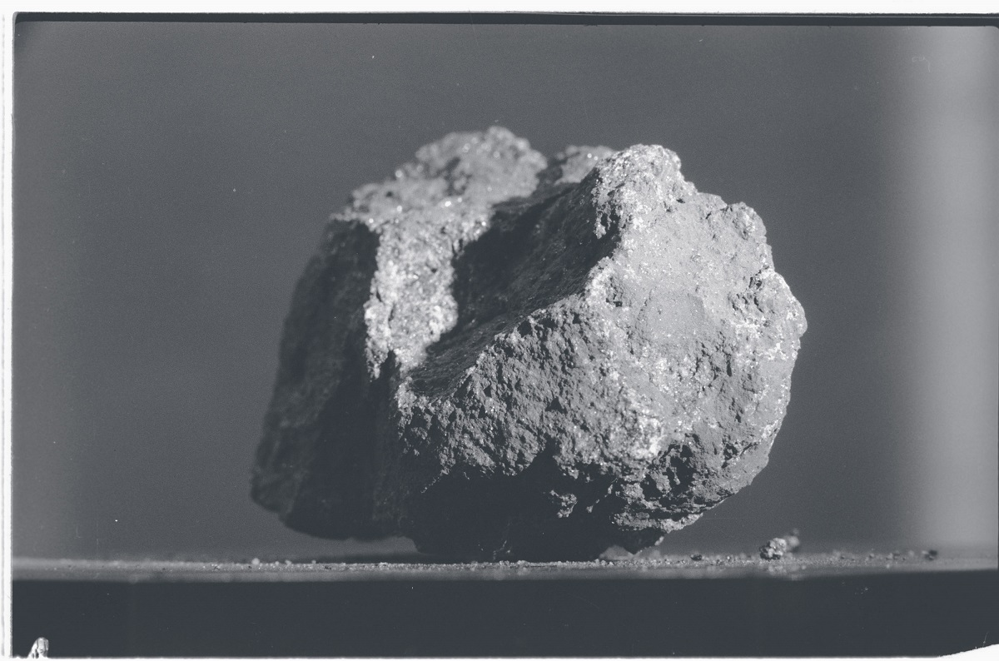
Basalt rock: Dig into a Moon crater
Notes:
Basalt is a dark rock. Scientists believe basalt comes from ancient volcanic eruptions on the Earth's Moon. When you look up at the Moon and see dark spots and patches, you're likely seeing basalt rock. Nearly 17% of the near side of the Moon is basalt, and only 2% of the far side is basalt. Most basalt in both of the Moon's hemispheres is found in basins or large craters.

Slide 9
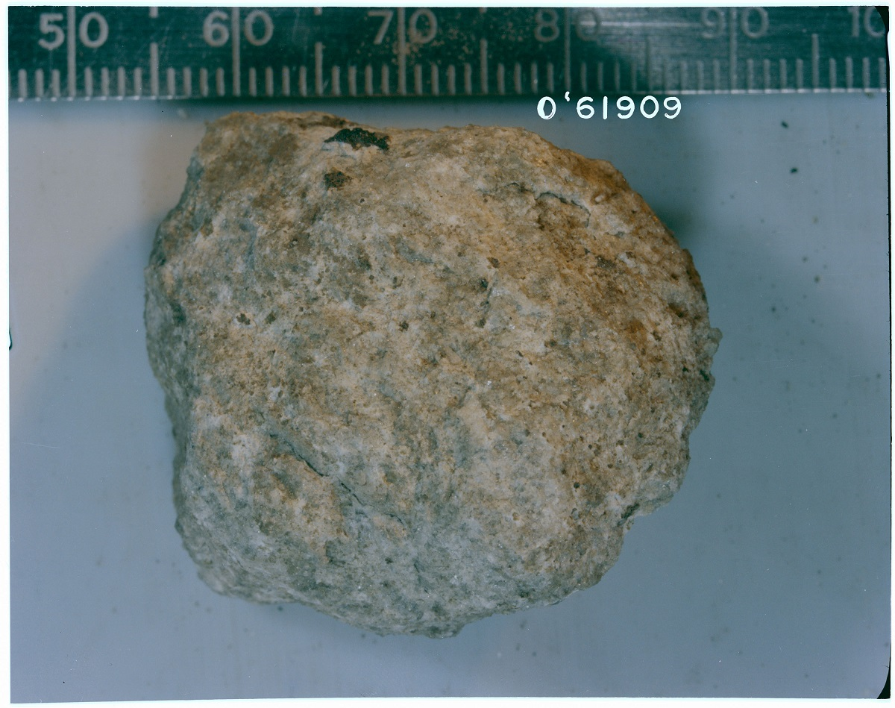
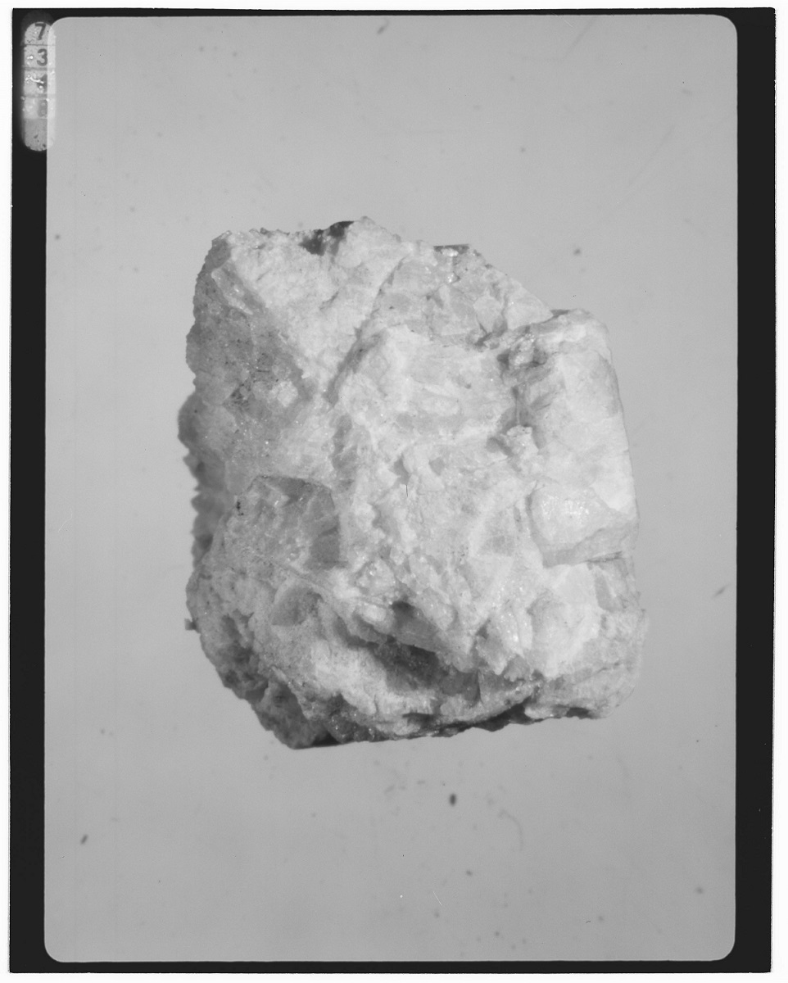
Highland rock: Brush the Moon's crust
Notes:
Highland rock is lighter than basalt rock because basalt is made of heavier elements like iron and magnesium. A theory about how highland rock was made is that a large magma ocean covered the Moon as it formed and then crystallized. Highland rock is lighter than basalt. The theory is the highland rock floated to the top of the ocean and became the crust of the Moon.

Slide 10
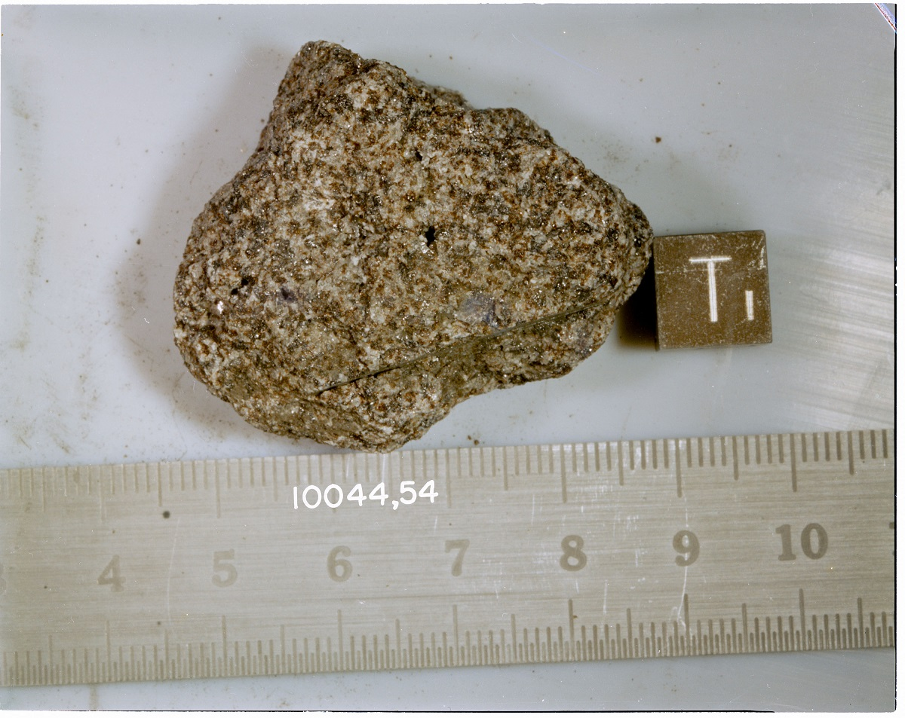
Exercise: Classify a Moon rock
What type of rock is shown in this picture?
Notes:
Take a careful look at the sample images for the different rock types shown in this unit. Do you think you could classify a new rock that astronauts recently gathered from the Moon?

Slide 11
This picture shows a basalt rock.
Notes:
Did you notice it can be difficult to classify this rock because it looks both like highland rock and basalt rock?
This exercise shows how artificial intelligence can assist humans in their research. Computers are great at finding the smaller details that are easily missed by the human eye.

Slide 12
Classify space rocks like a human
Notes:
To build an AI model to detect rock types, we need to consider how humans classify things.
In this section, we'll outline a common thought process that humans follow for examining and classifying data. Later, we'll use these steps to form a model for our computer to do the same tasks.

Slide 13
Step 1: Extract features
Color combinations
Sharp edges
Circular patterns
Texture in the rock's surface
The size of the rock
The size and shape of minerals in the rock
Notes:
First, our brain tries to extract patterns from each image. The patterns include the following factors:
Color combinations
Sharp edges
Circular patterns
Texture in the rock's surface
The size of the rock
The size and shape of minerals in the rock
Our brains subconsciously do all of these visual searches and categorization without our notice. In AI, we refer to these factors as features.

Slide 14
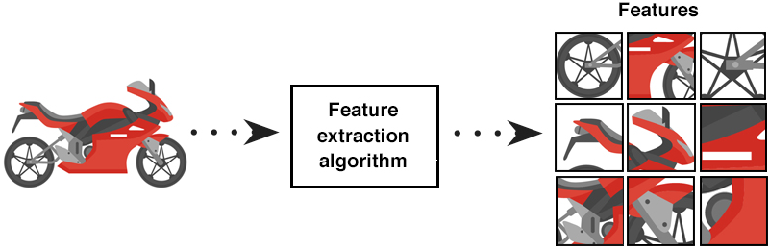
Notes:
This image lists some features we can extract from a photo of a motorcycle:

Slide 15
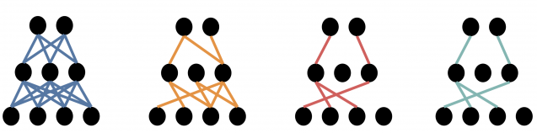
Step 2: Find relationships
Notes:
Next, we try to find the relationships between the features and the type of rock that's shown in a photo of a rock.
In this step, our brain tries to separate or collate the characteristics and features of each type of rock. Because of the associations we make, we come up with some rules. We determine that lighter rocks usually are highland rocks and that the texture of basalt rocks is more jagged. These associations and the links between them are demonstrated in the following image:

Slide 16
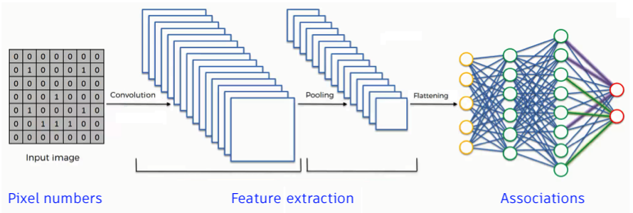
Step 3: Classify types
Notes:
Last, we try to use these relationships between known items to determine how to classify a new item. Given a new rock image to consider, our brains extract its characteristics. Then, our brain uses the associations we already made to determine what type of rock it is.

Slide 17
Classify space rocks by using artificial intelligence
Notes:
The job of the AI scientist in creating an AI model is to teach the computer how to accomplish the goal. For space rock research, the goal is 100% accuracy in the classification system. 100% seems impossible to humans. But, when scientists integrate computers and AI with their other research techniques, the goal comes within reach.
An AI model often implements the same or similar steps from the human process to achieve the goal. The scientist teaches by creating the model. The computer learns by repeating the model process. Each iteration of the model yields more data. The more data that's gathered and analyzed, the more accurate the computer can predict.
For our AI model, we'll start with the human steps for examining and classifying rocks. We'll teach the computer to follow these steps. After the computer runs the model and generates analysis data, it can accurately predict the rock type from new data.

Slide 18
Step 0: Get data Step 1: Extract features Step 2: Find associations Step 3: Predict types
Notes:
Step 0: Get data
A preparatory step is to import image data. We also need to get the libraries to help process the data on the computer tat we'll train. The computer transforms the images into matrixes of numbers so the images are in a format the computer can read.
Step 1: Extract features
From the rock photos (data) that we provide, the computer extracts features like texture, size, color, and edges. Scientists use intuition and experience to specify the features to look for.
Step 2: Find associations
The computer makes associations between image features and types of rock. Computers can be better than humans at the task of detecting minute details because there are so many associations to make.
The computer builds a network that can keep track of millions of associations.
Step 3: Predict types
The computer extracts defined rock features from a new photo. It uses associations between existing data and data from the new photo to predict the rock type.

Slide 19
Common Python libraries for AI projects
Matplotlib
NumPy
PyTorch
Other libraries
Notes:
Later in this learning path, we'll use three Python libraries:
Matplotlib
NumPy
PyTorch
The libraries are free and are commonly used in real-life AI projects.
Matplotlib
The Matplotlib library is primarily used to visualize data in Python. You can use Matplotlib to create static, animated, and interactive visualizations in Python. Matplotlib is useful for displaying your data in a more visual way.
NumPy
The NumPy library, short for Numerical Python, is a popular option that's used to organize and store data in Python. You can use NumPy to create structures to hold sets of data called arrays. Like lists, arrays store many types of data. NumPy has many functions that are helpful for manipulating data in arrays.
PyTorch
The PyTorch library is a machine-learning library. It has many built-in functions to help accelerate building projects. PyTorch primarily is used to modify data in an existing machine-learning program.
Other libraries
There are many other libraries that you can use to create an AI model. To learn about other common AI libraries and what they do, see Top 8 Python libraries for machine learning and artificial intelligence.

Slide 20
Exercise - Download Python AI libraries
Notes:
In this section, we'll install the libraries that you'll need to build your AI model as we continue in the learning path. We'll use Anaconda to complete the downloads. Anaconda is a distribution of the Python and R programming languages. It includes libraries for development in scientific computing like data science, machine learning, predictive analysis, and more.

Slide 21
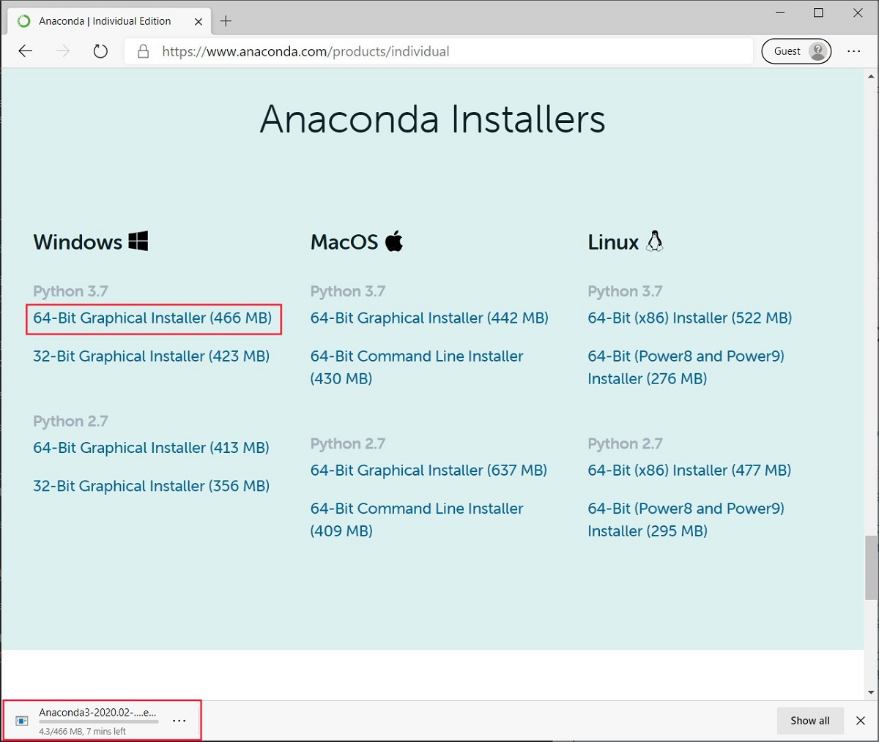
Download Anaconda
Go to the Anaconda download page to install Anaconda.
Select Download.
In the list of download links, select the link that corresponds to your computer operating system. Wait for the download to finish.
To start the installation, select the executable file in the lower-left corner of your browser. (You can also open the download folder and run the executable from that location.)
Complete the steps to install Anaconda on your computer.
Notes:
Follow these steps to download and install Anaconda.
Go to the Anaconda download page to install Anaconda.
Select Download.
In the list of download links, select the link that corresponds to your computer operating system.
Wait for the download to finish.
4. To start the installation, select the executable file in the lower-left corner of your browser. (You can also open the download folder and run the executable from that location.)
5. Complete the steps to install Anaconda on your computer.
After installation completes, the application is available on your computer:
If you're using Windows, run the Anaconda prompt from the Start menu.
On a Mac, run the Anaconda prompt in your computer Terminal.

Slide 22
Use Anaconda to install AI libraries
Notes:
In this section, we'll install the libraries that you'll need to build your AI model as we continue in the learning path. We'll use Anaconda to complete the downloads. Anaconda is a distribution of the Python and R programming languages. It includes libraries for development in scientific computing like data science, machine learning, predictive analysis, and more.

Slide 23
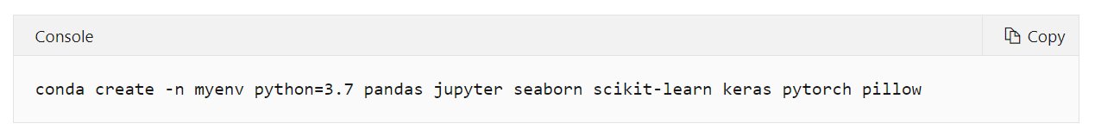
STEP 1 At the Anaconda prompt, run the conda create command to start the Anaconda environment:
This command uses Anaconda to install all the libraries that we need for our model. In this command, we're also downloading a few other libraries that are good for data science. You might find these libraries useful for future development.
Notes:
Follow these steps to create the environment:
At the Anaconda prompt, run the conda create command to start the Anaconda environment:
ConsoleCopy
conda create -n myenv python=3.7 pandas jupyter seaborn scikit-learn keras pytorch pillow This command uses Anaconda to install all the libraries that we need for our model. In this command, we're also downloading a few other libraries that are good for data science. You might find these libraries useful for future development.
When you're prompted to install the packages, enter Y, and then press Enter.
To activate your new environment, run the conda activate command:
ConsoleCopy
conda activate myenv
The new environment is ready to use, but we need to add one more library through a separate install command.

Slide 24
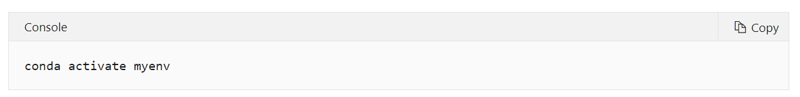
STEP 2
When you're prompted to install the packages, enter Y, and then press Enter.
STEP 3
To activate your new environment, run the conda activate command:
The new environment is ready to use, but we need to add one more library through a separate install command.
Notes:
Follow these steps to create the environment:
At the Anaconda prompt, run the conda create command to start the Anaconda environment:
ConsoleCopy
conda create -n myenv python=3.7 pandas jupyter seaborn scikit-learn keras pytorch pillow This command uses Anaconda to install all the libraries that we need for our model. In this command, we're also downloading a few other libraries that are good for data science. You might find these libraries useful for future development.
When you're prompted to install the packages, enter Y, and then press Enter.
To activate your new environment, run the conda activate command:
ConsoleCopy
conda activate myenv
The new environment is ready to use, but we need to add one more library through a separate install command.

Slide 25
Install torchvision package
Notes:
Install torchvision package
Follow these steps to install the torchvision package.
At the Anaconda prompt, run the conda install command:
ConsoleCopy
conda install -c pytorch torchvision
When you're prompted to install the package, enter Y, and then press Enter.

Slide 26
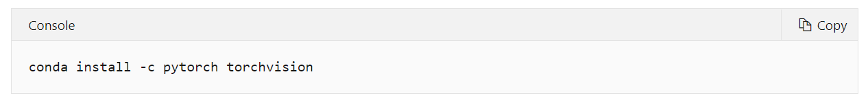
STEP 1
At the Anaconda prompt, run the conda install command:
When you're prompted to install the package, enter Y, and then press Enter.
Notes:
Install torchvision package
Follow these steps to install the torchvision package.
At the Anaconda prompt, run the conda install command:
ConsoleCopy
conda install -c pytorch torchvision
When you're prompted to install the package, enter Y, and then press Enter.

Slide 27
Create project folder and Jupyter Notebook file
Notes:
Create project folder and Jupyter Notebook file
Now you have an environment you can use for the rest of the learning path. The last step is to create a project folder for your source code files.
Choose an easily accessible location on your computer, and create a folder named ClassifySpaceRocks.
Open Visual Studio Code, and then open the folder you created.
Note
If you were running Visual Studio Code before your finished the install and set up of your Anaconda environment, you'll need to restart Visual Studio Code so the app can detect the environment.
Create a Jupyter Notebook file named ClassifySpaceRockProgram.
Enter Ctrl + Shift + P to open the Command dropdown menu at the top of Visual Studio.
Select Jupyter: Create new blank notebook.
A new notebook file opens. The system shows a message about connecting to the Python kernel in the lower-right corner.
Add the following comment in the first cell of the new notebook:
PythonCopy
# AI model to classify space rocks
Select the green arrow at the top of the cell to run it.
Enter Ctrl + S to save the file.
In the Save As dialog, browse to your folder.
Enter the name for the new notebook file. In our example, we'll use the name ClassifySpaceRockProgram. Make sure Jupyter is selected as the file type.
Select Save.
The saved Jupyter Notebook file should have the file extension .ipynb. You should see the file in the Explorer view in Visual Studio.
At the upper-right and lower-left corners of Visual Studio, change the environment to the new Anaconda environment you created.

Slide 28
STEP 1
Choose an easily accessible location on your computer, and create a folder named ClassifySpaceRocks.
STEP 2
Open Visual Studio Code, and then open the folder you created.
Notes:
Create project folder and Jupyter Notebook file
Now you have an environment you can use for the rest of the learning path. The last step is to create a project folder for your source code files.
Choose an easily accessible location on your computer, and create a folder named ClassifySpaceRocks.
Open Visual Studio Code, and then open the folder you created.
Note
If you were running Visual Studio Code before your finished the install and set up of your Anaconda environment, you'll need to restart Visual Studio Code so the app can detect the environment.
Create a Jupyter Notebook file named ClassifySpaceRockProgram.
Enter Ctrl + Shift + P to open the Command dropdown menu at the top of Visual Studio.
Select Jupyter: Create new blank notebook.
A new notebook file opens. The system shows a message about connecting to the Python kernel in the lower-right corner.
Add the following comment in the first cell of the new notebook:
PythonCopy
# AI model to classify space rocks
Select the green arrow at the top of the cell to run it.
Enter Ctrl + S to save the file.
In the Save As dialog, browse to your folder.
Enter the name for the new notebook file. In our example, we'll use the name ClassifySpaceRockProgram. Make sure Jupyter is selected as the file type.
Select Save.
The saved Jupyter Notebook file should have the file extension .ipynb. You should see the file in the Explorer view in Visual Studio.
At the upper-right and lower-left corners of Visual Studio, change the environment to the new Anaconda environment you created.

Slide 29
STEP 3
Create a Jupyter Notebook file named ClassifySpaceRockProgram.
Enter Ctrl + Shift + P to open the Command dropdown menu at the top of Visual Studio.
Select Jupyter: Create new blank notebook. A new notebook file opens. The system shows a message about connecting to the Python kernel in the lower-right corner.
Add the following comment in the first cell of the new notebook: # AI model to classify space rocks
Select the green arrow at the top of the cell to run it.
Enter Ctrl + S to save the file.
In the Save As dialog, browse to your folder.
Enter the name for the new notebook file. In our example, we'll use the name ClassifySpaceRockProgram. Make sure Jupyter is selected as the file type.
Select Save.
Notes:
Create project folder and Jupyter Notebook file
Now you have an environment you can use for the rest of the learning path. The last step is to create a project folder for your source code files.
Choose an easily accessible location on your computer, and create a folder named ClassifySpaceRocks.
Open Visual Studio Code, and then open the folder you created.
Note
If you were running Visual Studio Code before your finished the install and set up of your Anaconda environment, you'll need to restart Visual Studio Code so the app can detect the environment.
Create a Jupyter Notebook file named ClassifySpaceRockProgram.
Enter Ctrl + Shift + P to open the Command dropdown menu at the top of Visual Studio.
Select Jupyter: Create new blank notebook.
A new notebook file opens. The system shows a message about connecting to the Python kernel in the lower-right corner.
Add the following comment in the first cell of the new notebook:
PythonCopy
# AI model to classify space rocks
Select the green arrow at the top of the cell to run it.
Enter Ctrl + S to save the file.
In the Save As dialog, browse to your folder.
Enter the name for the new notebook file. In our example, we'll use the name ClassifySpaceRockProgram. Make sure Jupyter is selected as the file type.
Select Save.
The saved Jupyter Notebook file should have the file extension .ipynb. You should see the file in the Explorer view in Visual Studio.
At the upper-right and lower-left corners of Visual Studio, change the environment to the new Anaconda environment you created. Congratulations! You've installed all the libraries you need to make an AI program, and configured Visual Studio Code to find them.

Slide 30
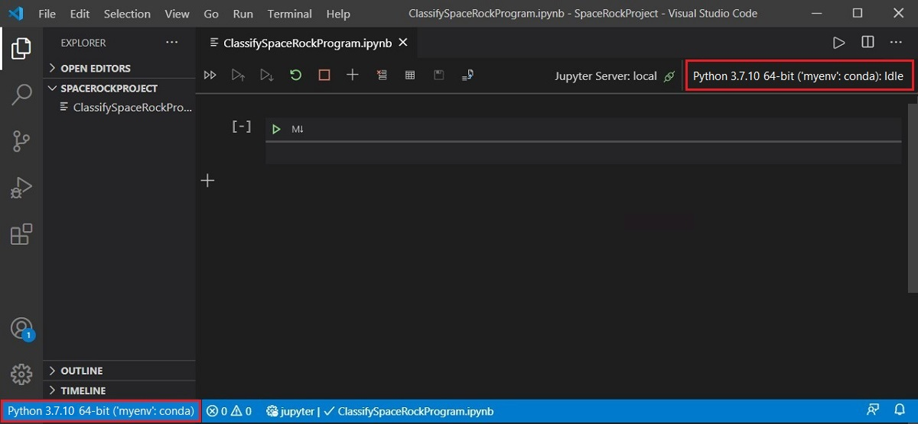
STEP 4
At the upper-right and lower-left corners of Visual Studio, change the environment to the new Anaconda environment you created.
Notes:
Create project folder and Jupyter Notebook file
Now you have an environment you can use for the rest of the learning path. The last step is to create a project folder for your source code files.
Choose an easily accessible location on your computer, and create a folder named ClassifySpaceRocks.
Open Visual Studio Code, and then open the folder you created.
Note
If you were running Visual Studio Code before your finished the install and set up of your Anaconda environment, you'll need to restart Visual Studio Code so the app can detect the environment.
Create a Jupyter Notebook file named ClassifySpaceRockProgram.
Enter Ctrl + Shift + P to open the Command dropdown menu at the top of Visual Studio.
Select Jupyter: Create new blank notebook.
A new notebook file opens. The system shows a message about connecting to the Python kernel in the lower-right corner.
Add the following comment in the first cell of the new notebook:
PythonCopy
# AI model to classify space rocks
Select the green arrow at the top of the cell to run it.
Enter Ctrl + S to save the file.
In the Save As dialog, browse to your folder.
Enter the name for the new notebook file. In our example, we'll use the name ClassifySpaceRockProgram. Make sure Jupyter is selected as the file type.
Select Save.
The saved Jupyter Notebook file should have the file extension .ipynb. You should see the file in the Explorer view in Visual Studio.
At the upper-right and lower-left corners of Visual Studio, change the environment to the new Anaconda environment you created. Congratulations! You've installed all the libraries you need to make an AI program, and configured Visual Studio Code to find them.

Slide 31

QUIZ TIME!!!
https://forms.office.com/r/k5us7DP3Cy
Notes:
In this lesson, you learned more about space rocks and AI.
You studied the differences between basalt and highland rock, and learned how distinguishing characteristics, or features, help to form classifications.
You considered the steps humans follow to examine and classify objects, and then reviewed how we can teach machines to classify objects by following a similar process.
You learned about different Python libraries for AI, including Matplotlib, NumPy, and PyTorch.
You used Anaconda to download the Python libraries to your computer and installed them in preparation for building an AI model.

Slide 32
THANK YOU SO MUCH!!!

